Slide 1
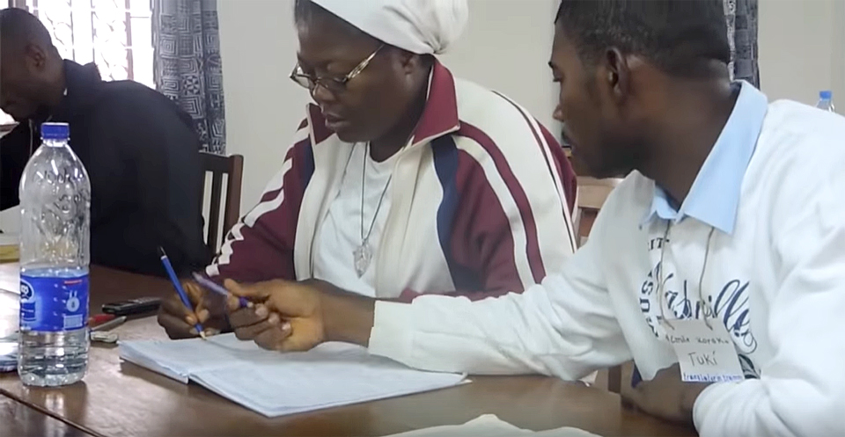
Four Drafting Steps

Slide 2
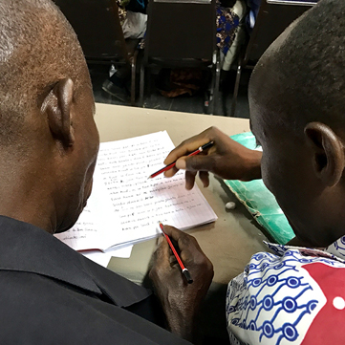

Eight-Step Translation Method
Drafting Steps
Checking Steps
Consume
Verbalize
Chunk
Blind Draft
Self-edit
Peer-edit
Key Word Check
Verse-by-Verse Check

Slide 3
Step 1: Consume
5–7 minutes
Alone
How sweet are your words to my taste, yes, sweeter than honey to my mouth! Psalm 119:103
  Process: 1. Read the passage in the source text
  2. Think about the meaning of the passage
Benefits:
  Understand the overview and main points
  Get the passage into your short-term memory
  Tip: Highlighting or underlining in this step is good, but any deeper note-taking interrupts your thought flow and short-term memory.

Slide 4
Step 2: Verbalize
2-3 minutes
With a partner, or alone
With my mouth I have declared all the righteous decrees that you have revealed.
Psalm 119:13
  Process: Speak out loud in your own language what
  you just read
Benefits:
  Your mind begins to process and sort the information
  The passage moves into your working memory; you remember more
  Tips: Always speak the passage out loud, even if you have no partner to listen. Try to remember the main points and summarize the passage.

Slide 5
Step 3: Chunk
5–7 minutes
Alone
Open my eyes so that I may see marvelous things in your law.
Psalm 119:18
Process: Divide the passage into smaller parts
Benefits:
  Your mind has to categorize and analyze the information
  You recognize the flow of the passage
  The passage is now moving into your long-term memory
Tips: Divide the passage at natural transitions or topic breaks.
Make your chunks small enough to easily remember the main points, but long enough that you cannot memorize the text.

Slide 6
Step 4: Blind Draft
No
time limit
Alone
I have stored up your word in my heart so that I might not sin against you. Blessed you are, Yahweh; teach me your statutes. Psalm 119:11-12
Process: 1. Re-read the first chunk in your source text
2. Close the source text and draft the first chunk in your heart language without looking back
3. Repeat for each chunk
Benefits:
  Free your mind from the words and structure of the source language
  Draft a natural sounding translation
  Focus on re-stating the meaning (not the wording)
Tips: Skip a line between each line of your draft to leave room for corrections. Don’t worry about marking verse numbers for now.
Don’t worry if you forget something. This is only your first draft!

Slide 7


Drafting Steps Summarized
1
2
3
4
Consume
Verbalize
Chunk
Blind Draft
Think about
what the
passage means
Summarize
the passage out loud in your language
Break the passage down into smaller pieces based on meaning
Draft
each chunk
from memory
5–7 min.
2–3 min.
1–4 verses
no source text

Slide 8
Try it
Are you surprised by what you can do?
What is difficult?
Are you ready for the next steps?

Slide 9

All Scripture taken from the English Unlocked Literal Bible (ULB), ©2017, 2022 Wycliffe Associates, Available at https://bibleineverylanguage.org/translations, licensed under the Creative Commons Attribution-ShareAlike 4.0 International License.
The English ULB is based on the unfoldingWord® Literal Text, CC BY-SA 4.0. The original work of the unfoldingWord® Literal Text is available at https://unfoldingword.bible/ult/.

